Slide 1

ICT502
Week 3: Evaluating Design Options for IT Projects
ICT502 Applied IT Project A
1

Slide 2
Preparation for Assessment 2 – Group Contract + Initial Research
What is this assignment about?
You are doing two things together:
1. Initial Project Research (Think + Plan)
- Choose a real IT problem
- Do basic research
- Suggest possible solutions and technologies

Slide 3
Preparation for Assessment 2 – Group Contract + Initial Research
2. Group Contract (How your team will work)
- Set rules for teamwork
- Decide roles, communication, and responsibilities
Then combine everything into a ~1,500-word report

Slide 4
Preparation for Assessment 2 – Group Contract + Initial Research
PART 1: Initial Research (Simple Explanation)
Step 1: Choose a Topic (Problem)
Pick something real-world + IT-related
Examples:
- Online shopping fraud detection
- Smart parking system
- AI chatbot for customer service
- Student attendance tracking system
Keep it simple and realistic for one semester

Slide 5
Preparation for Assessment 2 – Group Contract + Initial Research
Step 2: Define the Problem
Ask:
- What is the problem?
- Who has this problem?
- Why is it important?

Slide 6
Preparation for Assessment 2 – Group Contract + Initial Research
Example:
Many small businesses lose customers because they don’t respond quickly to online queries. This project explores a chatbot solution.

Slide 7
Preparation for Assessment 2 – Group Contract + Initial Research
Step 3: Do Basic Research
Find 3–5 good sources (Google Scholar, reports, journals)
Look for:
- What already exists?
- What problems still exist?
- What can be improved?

Slide 8
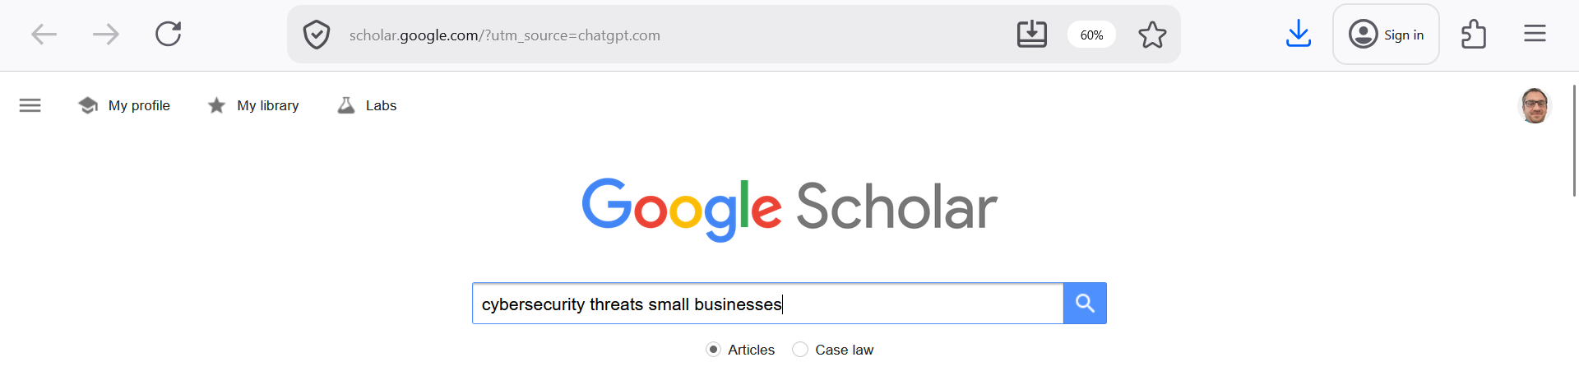
Preparation for Assessment 2 – Group Contract + Initial Research
1. Use Google Scholar (MAIN TOOL)
Search on Google Scholar
- Free and easy to use
- Searches journals, conference papers, reports, theses

Slide 9
Preparation for Assessment 2 – Group Contract + Initial Research
2. Other useful databases (optional)
- Scopus
- Web of Science
- IEEE Xplore
- ScienceDirect
These databases contain peer-reviewed and high-quality research papers

Slide 10
Preparation for Assessment 2 – Group Contract + Initial Research
Good Journals for Information Systems (Simple List)
You do NOT need to remember all — just use Google Scholar and filter results.

Slide 11
Preparation for Assessment 2 – Group Contract + Initial Research
Top Journals (High Quality)
- MIS Quarterly
- Information Systems Research
- Journal of Information Technology
- Journal of Management Information Systems
- Journal of the Association for Information Systems
These are well-known and trusted journals in IT and business systems research

Slide 12
Preparation for Assessment 2 – Group Contract + Initial Research
Easier / Practical Journals (Good for students)
- Information Systems (Elsevier)
- Systems (MDPI)
- IEEE / ACM conference papers
These often include real-world applications and case studies

Slide 13
Preparation for Assessment 2 – Group Contract + Initial Research
Keywords (VERY IMPORTANT)
You may struggle here, so use this simple rule:
Use this format:
[technology] + [problem] + [context]

Slide 14
Preparation for Assessment 2 – Group Contract + Initial Research
Topic: Cybersecurity
- "cybersecurity threats small business"
- "data breach prevention techniques"
- "information security challenges organisations"

Slide 15
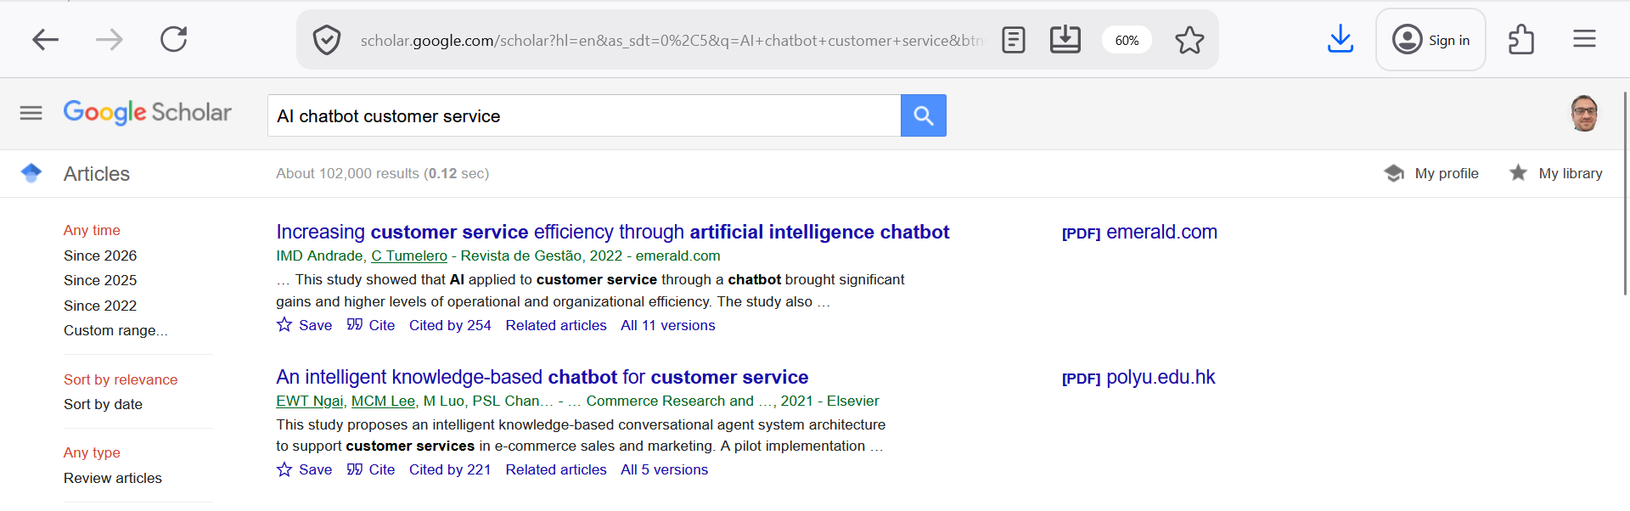
Preparation for Assessment 2 – Group Contract + Initial Research
Topic: Chatbot
- "AI chatbot customer service"
- "chatbot business applications"
- "customer support automation challenges"

Slide 16
Preparation for Assessment 2 – Group Contract + Initial Research
Basic Search:
- "AI chatbot for customer service in small business"
- "challenges of cybersecurity in SMEs"
- "IoT smart parking system research"

Slide 17
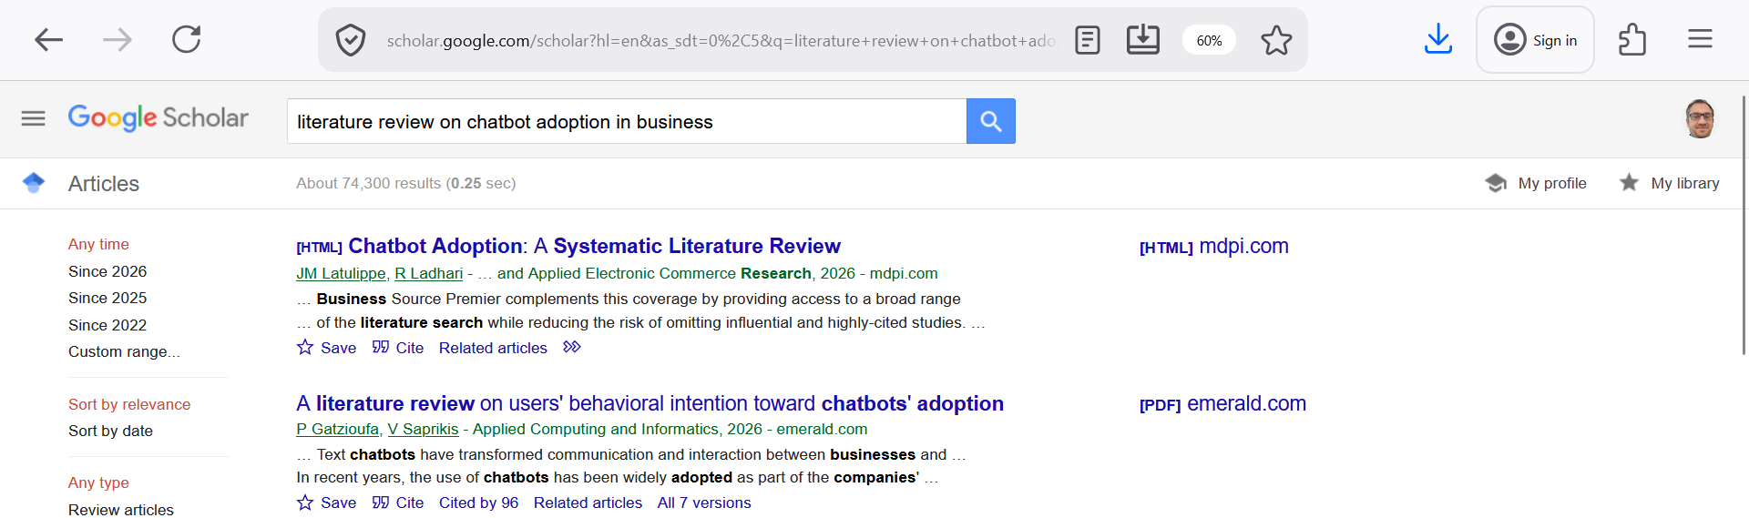
Preparation for Assessment 2 – Group Contract + Initial Research
More Academic Style:
- "literature review on chatbot adoption in business"
- "factors affecting e-commerce security systems"
- "evaluation of IoT applications in smart cities"

Slide 18
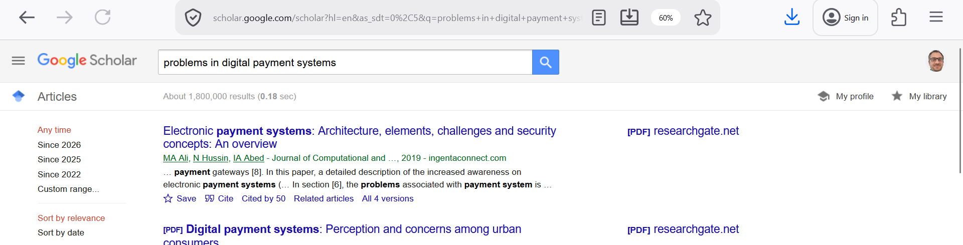
Preparation for Assessment 2 – Group Contract + Initial Research
For Problems:
- "limitations of chatbot systems in customer service"
- "issues in cloud computing security"
- "problems in digital payment systems"

Slide 19
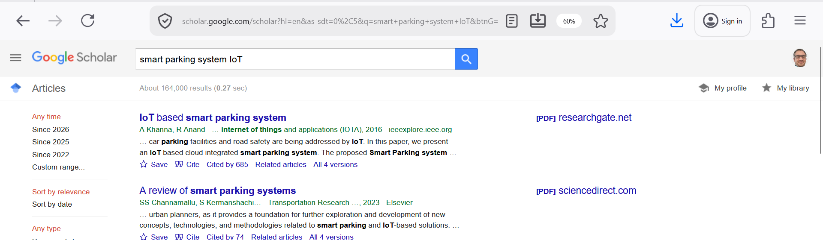
Preparation for Assessment 2 – Group Contract + Initial Research
Topic: Smart Systems
- "smart parking system IoT"
- "IoT smart city challenges"
- "sensor-based parking solutions"

Slide 20
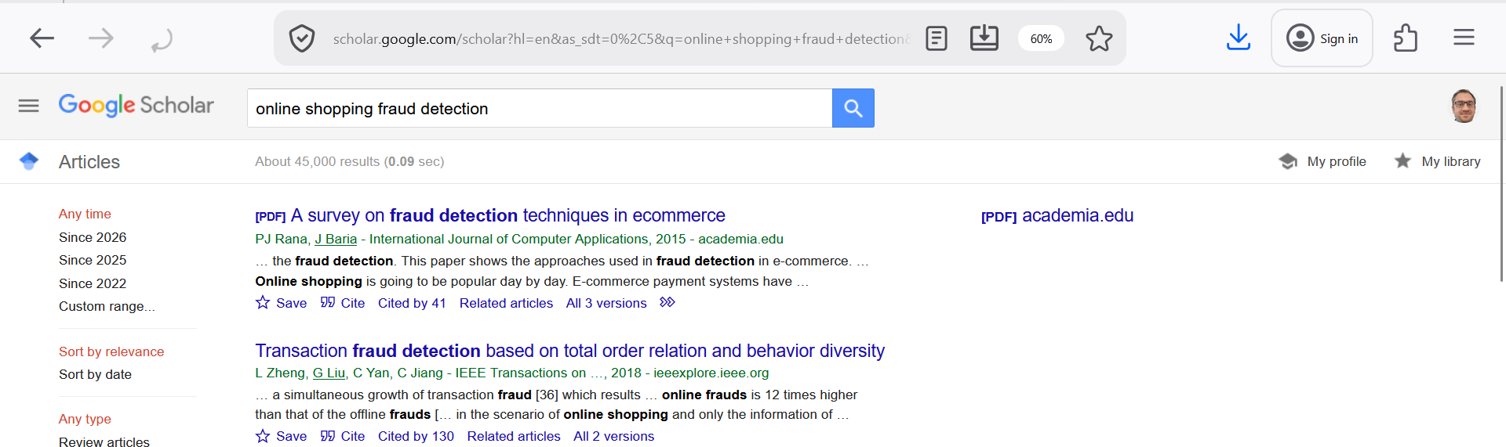
Preparation for Assessment 2 – Group Contract + Initial Research
Topic: E-commerce
- "online shopping fraud detection"
- "e-commerce security issues"
- "recommendation systems online retail"

Slide 21
Preparation for Assessment 2 – Group Contract + Initial Research
1. What already exists?
Example:
Many companies use chatbots
2. What problems still exist?
Example:
Chatbots cannot understand complex questions

Slide 22
Preparation for Assessment 2 – Group Contract + Initial Research
3. What can be improved?
Example:
Add AI + natural language processing

Slide 23
Preparation for Assessment 2 – Group Contract + Initial Research
Simple Example (Full Demonstration)
Topic: Smart Parking
Search:
"smart parking system IoT challenges"
Findings:
- Exists: sensors + mobile apps
- Problem: inaccurate data
- Improvement: real-time AI prediction

Slide 24
Preparation for Assessment 2 – Group Contract + Initial Research
Keywords for IT Governance
Combine: "IT governance" + (focus area)
Basic Keywords (Start here)
- "IT governance"
- "IT governance frameworks"
- "IT governance in organisations"
- "IT governance importance"

Slide 25
Preparation for Assessment 2 – Group Contract + Initial Research
Keywords by Focus Area
1. Governance Frameworks
- "COBIT IT governance framework"
- "ITIL governance practices"
- "ISO 38500 IT governance"

Slide 26
Preparation for Assessment 2 – Group Contract + Initial Research
2. Business Alignment
- "IT business alignment governance"
- "IT strategy alignment organisations"

Slide 27
Preparation for Assessment 2 – Group Contract + Initial Research
3. Risk & Security
- "IT governance risk management"
- "information security governance"
- "cybersecurity governance framework"

Slide 28
Preparation for Assessment 2 – Group Contract + Initial Research
4. Performance / Value
- "IT governance value creation"
- "IT project success governance"
- "IT governance performance measurement"

Slide 29
Preparation for Assessment 2 – Group Contract + Initial Research
5. SMEs / Real-world context
- "IT governance small business"
- "IT governance challenges SMEs"
- "IT governance adoption barriers"

Slide 30
Preparation for Assessment 2 – Group Contract + Initial Research
Basic Searches:
- "IT governance frameworks and their effectiveness"
- "role of IT governance in business performance"
- "IT governance challenges in organisations"

Slide 31
Preparation for Assessment 2 – Group Contract + Initial Research
More Advanced (Better for marks):
- "impact of IT governance on organisational performance"
- "evaluation of COBIT framework in IT governance"
- "barriers to IT governance implementation in SMEs"

Slide 32
Preparation for Assessment 2 – Group Contract + Initial Research
For Problems (IMPORTANT):
- "issues in IT governance implementation"
- "limitations of IT governance frameworks"
- "challenges of aligning IT and business strategy"

Slide 33
Preparation for Assessment 2 – Group Contract + Initial Research
Example (What Students Should Find)
Topic: IT Governance in Small Businesses
After Searching:
What exists:
- Frameworks like COBIT and ITIL
- Policies for managing IT

Slide 34
Preparation for Assessment 2 – Group Contract + Initial Research
Problems:
- Too complex for small companies
- Lack of skilled staff
Improvements:
- Simpler governance models
- Automation tools

Slide 35
Preparation for Assessment 2 – Group Contract + Initial Research
Good Research Topic Ideas (Using IT Governance)
You can suggest these to students:
IT Governance in SMEs
Role of IT Governance in Cybersecurity
IT Governance and Digital Transformation
Comparing COBIT vs ITIL
IT Governance for Cloud Computing
IT Governance in Healthcare Systems

Slide 36
Quick In-Class Activity (5–10 min)
Choose a topic (e.g., IT governance + cybersecurity, or IT governance + SMEs)
Search 1 sentence in Google Scholar
Find:
1 existing solution
1 problem
1 improvement
Present your research finding
Don’t just search ‘IT governance’. Add a focus like security, SMEs, or performance to get better results.

Slide 37
Preparation for Assessment 2 – Group Contract + Initial Research
Small and Medium-sized Enterprises (SMEs):
SMEs are small or medium businesses, not large companies.
Examples:
- Local retail shops
- Small IT companies
- Startups
- Small consulting firms

Slide 38
Preparation for Assessment 2 – Group Contract + Initial Research
Type | Employees
Small business | Usually < 50
Medium business | Usually < 250

Slide 39
Preparation for Assessment 2 – Group Contract + Initial Research
Why SMEs are important in your assignment?
Many IT topics (like IT governance) focus on SMEs because:
They have limited budget
They have fewer IT experts
They face more challenges implementing systems

Slide 40
Preparation for Assessment 2 – Group Contract + Initial Research
Example in your topic
“IT governance in SMEs” means:
How small and medium businesses:
manage IT
control risks
use technology effectively

Slide 41
Preparation for Assessment 2 – Group Contract + Initial Research
Good research is not about reading everything — it’s about finding the right 3–5 strong sources and understanding them clearly.

Slide 42
Preparation for Assessment 2 – Group Contract + Initial Research
Common Mistakes
X Too general: "IT governance is important" X No specific problem X No real-world context X No comparison or evaluation

Slide 43
What we learned last week
6-step requirements gathering process
Requirements gathering techniques
Stakeholder analysis and engagement
Creating requirement documentation
Tools and techniques for effective data collection
Design Thinking in IT Project

Slide 44
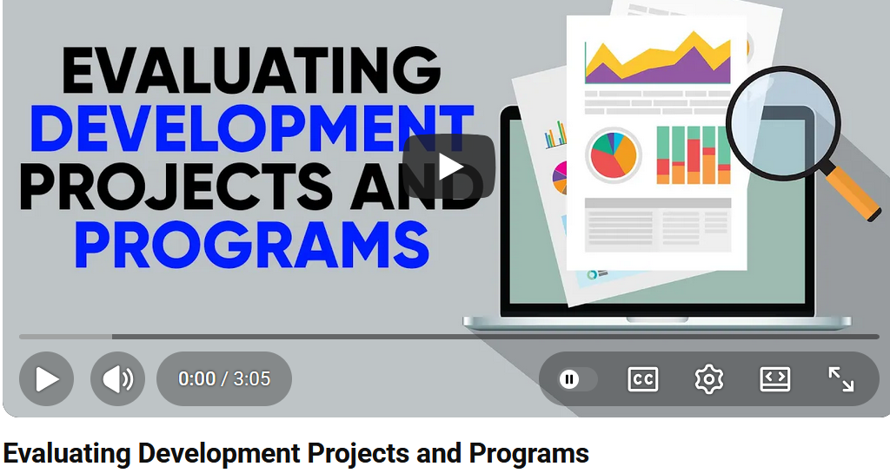
Week 3 Pre-Class Readings
YouTube Video:
Evaluating Development Projects and Programs
https://www.youtube.com/watch?v=2KqwMleovVU

Slide 45
Week 3 Pre-Class Readings
1. Evaluation is important
The speaker keeps mentioning evaluation
Meaning:
You must check and measure how well something works
Example: Is your IT system successful? Is it useful?

Slide 46
Week 3 Pre-Class Readings
2. Continuous improvement
Words like adjustments, improvement, ongoing projects
Meaning:
Projects are not finished once built
You must keep improving them

Slide 47
Week 3 Pre-Class Readings
3. IT systems support organisations
Mentions of company products, systems, departments
Meaning:
IT helps different parts of a company work better
Example:
Sales system
Customer service system

Slide 48
Week 3 Pre-Class Readings
4. Integration is important
Words like integrated, departments, connection
Meaning:
Systems should work together
Example:
Customer data shared between sales and support

Slide 49
Week 3 Pre-Class Readings
5. Risk and challenges exist
Mentions of problems, issues, environment
Meaning:
Every IT project has:
Risks
Difficulties
You must identify and manage them

Slide 50
Week 3 Pre-Class Readings
6. Performance and effectiveness
Words like performance, effectiveness
Meaning:
Measure if the system:
Saves time
Improves work
Adds value

Slide 51
Week 3 Pre-Class Readings
7. Collaboration between teams
Mentions of departments, communication
Meaning:
Teams must:
Communicate
Work together

Slide 52
Week 3 Pre-Class Readings
8. Real-world application
Mentions of practice, environment
Meaning:
IT is not just theory
It must work in real situations

Slide 53
Week 3 Pre-Class Readings
The main message is: IT projects must be evaluated, improved continuously, integrated across departments, and aligned with real business needs while managing risks.

Slide 54
Week 3 Pre-Class Readings
Example (Relate to your assignment)
Project: Chatbot system
Evaluation → Does it answer correctly?
Improvement → Add better AI responses
Integration → Connect to database
Performance → Faster customer response
Risk → Wrong answers
Collaboration → Team works together

Slide 55
Week 3 Pre-Class Readings
focus on big ideas:
Evaluation
Improvement
Integration
Performance
Teamwork
Real-world use”

Slide 56
Week 3 Topics
Criteria for selecting technology solutions
Comparative analysis of different technologies
Impact of Emerging Technologies on Design Choices
Risk Assessment in Design Option Evaluation
User-Centered Design Approaches in IT Projects

Slide 57
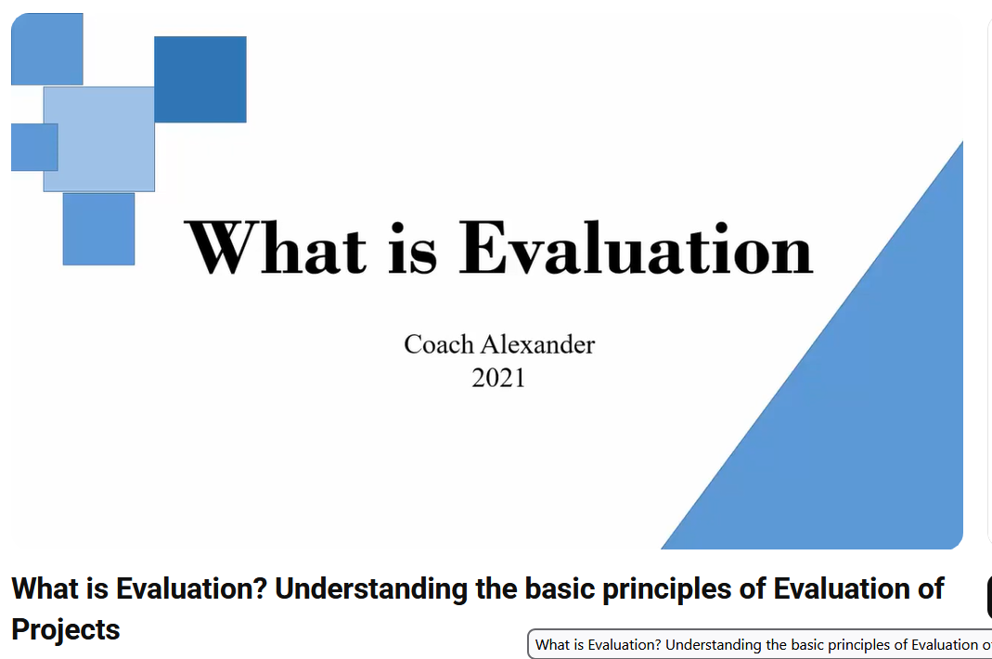
Pre-Class Discussion
What is Evaluation?
What are the principles of Evaluation of Projects?
Youtube: https://www.youtube.com/watch?v=8ej9F-tuxg4

Slide 58
Pre-Class Discussion
1. What is Evaluation?
Evaluation = checking if a project achieved its goals
- Did we do what we planned?
- Did it work or not?
Example:
Build a road → Check if it is completed correctly

Slide 59
Pre-Class Discussion
2. When do we do evaluation?
Not only at the end!
- Beginning → set baseline
- Middle → check progress
- End → check final result

Slide 60
Pre-Class Discussion
3. Why is evaluation important?
To improve performance
- Not just succeed, but do better next time

Slide 61
Pre-Class Discussion
To ensure accountability
- Everyone is responsible
- No blaming others

Slide 62
Pre-Class Discussion
To support decision-making
- Helps managers make better decisions

Slide 63
Pre-Class Discussion
To learn for future projects
- Learn from mistakes
- Improve future work

Slide 64
Pre-Class Discussion
4. Continuous improvement
Projects should always improve
- Learn from past mistakes
- Make better versions (like new car models)

Slide 65
Pre-Class Discussion
5. Evaluation is NOT just finding faults
It is NOT:
- Blaming people
- Only checking errors
It IS:
- Learning
- Improving
- Working together

Slide 66
Pre-Class Discussion
6. Key Evaluation Criteria (VERY IMPORTANT)
1. Sustainability
Can the project continue long-term?
Example:
- Can system run without extra funding?

Slide 67
Pre-Class Discussion
2. Effectiveness
Did we achieve the goal?
Example:
- Did income actually increase?

Slide 68
Pre-Class Discussion
3. Efficiency
Did we use resources well?
Example:
- Did we save time/money?

Slide 69
Pre-Class Discussion
4. Relevance
Is the project useful?
Example:
- Does it solve a real problem?

Slide 70
Pre-Class Discussion
5. Impact
What is the overall change?
Example:
- Did it improve people’s lives?

Slide 71
Pre-Class Discussion
Real-world application
Evaluation applies to:
- IT projects
- Business
- Personal goals
Example:
“Did I achieve my goal in 5 years?”

Slide 72
Pre-Class Discussion
Evaluation means checking if a project worked, learning from it, and improving future performance.

Slide 73
Pre-Class Discussion
Example (Relate to their assignment)
Project: IT System
- Effectiveness → Does it work?
- Efficiency → Is it fast & low cost?
- Relevance → Do users need it?
- Impact → Does it help business?
- Sustainability → Can it continue long-term?

Slide 74
Pre-Class Discussion
In your assignment, you are not building the system yet — but you must think like evaluators:
- What problem are we solving?
- How will we know it works?”

Slide 75
In-Class Discussion Questions (2–3 min each)
Question 1
What is evaluation in simple terms?
Evaluation means checking if a project achieved its goals. It helps us understand what worked and what did not.

Slide 76
In-Class Discussion Questions (2–3 min each)
Question 2
Why is evaluation important in IT projects?
- Helps improve the system
- Shows if the project is successful
- Helps make better decisions in the future

Slide 77
In-Class Discussion Questions (2–3 min each)
Question 3
When should evaluation be done?
- At the beginning → to set a starting point
- During the project → to check progress
- At the end → to measure results

Slide 78
In-Class Discussion Questions (2–3 min each)
Question 4
What is one real-world example of evaluation?
Example: Build a mobile app → test if users can use it easily If not → improve the design

Slide 79
In-Class Discussion Questions (2–3 min each)
Question 5
What is one problem if we do NOT evaluate a project?
- We don’t know if it works
- We may repeat mistakes
- Waste time and money

Slide 80
In-Class Discussion Questions (2–3 min each)
Question 6
What is “efficiency” in simple terms?
Efficiency means doing the work using less time, money, or resources.
Example:
- Same result but faster = efficient

Slide 81
In-Class Discussion Questions (2–3 min each)
Question 7
What is “relevance” in a project?
Relevance means the project solves a real problem.
Example:
Building an app no one needs = not relevant

Slide 82
In-Class Discussion Questions (2–3 min each)
Question 8
Why is teamwork important in group projects?
Tasks are shared
Ideas improve
Work is completed faster
Helps avoid conflict

Slide 83
In-Class Discussion Questions (4–5 min each)
Question 9
Give one example of a good IT project idea and explain why it is useful.
Example: Smart parking system
Helps drivers find parking
Saves time
Reduces traffic

Slide 84
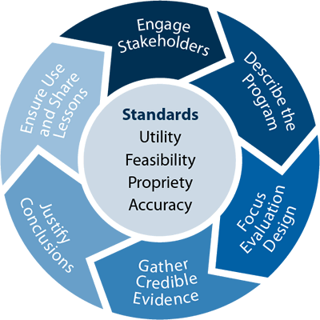
What Is Project Evaluation?

Slide 85
Introduction to evaluation of design
What is a Project Evaluation?
The project evaluation is a methodology developed to identify a project’s success and impact in the market. It’s also applied to programs and policies.
Overview
Objective Assessment: Evaluates if project goals were achieved.
Performance Review: Assesses schedule, budget, and deliverable quality.
Stakeholder Satisfaction: Gauges feedback from stakeholders.
Benefit Realisation: Measures achieved benefits like cost savings or efficiency gains.
Risk and Issue Management: Reviews effectiveness in handling risks and issues.
Lessons Learned: Captures insights for future improvements and practices.

Slide 86
Introduction to evaluation of design(Cont.)
Why evaluation of design options is important?
Optimisation: Helps identify the most effective solution that meets project goals.
Risk Management: Allows for early identification and mitigation of potential risks.
Cost Efficiency: Ensures resources are used efficiently by choosing the most cost-effective solution.
Stakeholder Alignment: Ensures the chosen solution aligns with stakeholder expectations and needs.
Innovation: Encourages exploration of new technologies and methodologies.
Quality Assurance: Ensures the final solution meets desired quality standards.

Slide 87
Criteria for Selecting Technology Solutions
Performance and Scalability:
Understanding scalability: vertical vs. horizontal
Performance metrics: response time, throughput
Cost-effectiveness:
Budget considerations: initial vs. ongoing costs
Total cost of ownership (TCO) analysis: initial investment, operational costs, maintenance
ROI calculations and value proposition

Slide 88
Criteria for Selecting Technology Solutions (Cont.)
Security and Compliance:
Security measures: encryption, authentication, access control
Compliance with regulatory requirements: GDPR, HIPAA, PCI DSS
Support and Maintenance:
Availability of technical support: 24/7 support, response time
Maintenance requirements: updates, patches, version control

Slide 89
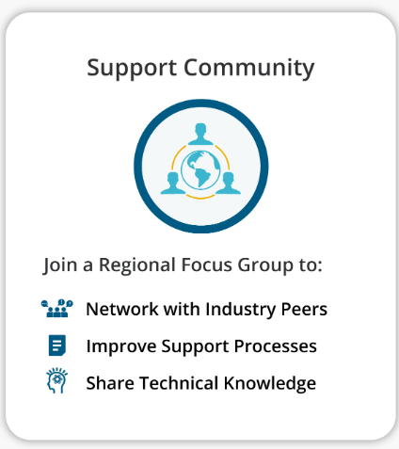
Criteria for Selecting Technology Solutions (Cont.)
Vendor Support and Community
Role of vendor support in technology selection
Evaluating vendor reputation and support services
Importance of community and open-source contributions

Slide 90
Comparative Analysis of Different Technologies
Definition: Comparative analysis involves evaluating multiple technologies to determine the most suitable option for a specific project or use case.
Purpose:
Identify strengths and weaknesses of each technology.
Make informed decisions based on specific project needs.
Minimise risks and maximise efficiency.

Slide 91
Comparative Analysis of Different Technologies: Methodologies (Cont.)
Methodologies:
Feature Comparison:
Comparative feature matrix: functionalities, performance benchmarks
User requirements mapping to technology features
Performance Testing:
Benchmarking: load testing, stress testing, reliability testing
Real-world performance scenarios and simulations
User Feedback and Reviews:
Gathering user experiences: surveys, focus groups, usability testing
Analysing customer satisfaction and user adoption rates

Slide 92
Comparative Analysis of Different Technologies: Methodologies (Cont.)
Methodology: Integrating Methodologies in Comparative Analysis
Combining Data Sources:
Cross-reference feature matrices with performance benchmarks to ensure capabilities meet expectations.
Validating with User Feedback:
Use user feedback to confirm findings from feature and performance analysis, prioritising features based on satisfaction and adoption rates.
Holistic Decision Making:
Integrate insights from feature comparison, performance testing, and user feedback for well-rounded, informed technology decisions.

Slide 93
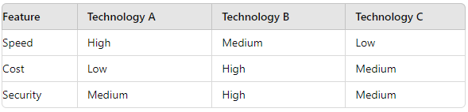
Methodologies: Feature Comparison
Comparative Feature Matrix:
Functionality: Assess key features of each technology.
Performance Benchmarks: Compare speed, efficiency, and scalability.
User Requirements Mapping:
Alignment: Match technology features with specific user needs.
Prioritisation: Identify which features are most critical for the project.
Example Matrix:

Slide 94
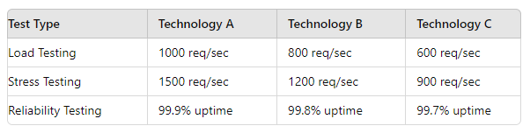
Methodologies: Performance Testing
Benchmarking:
Load Testing: Evaluate how the technology performs under expected user load.
Stress Testing: Determine the technology's breaking point under extreme conditions.
Reliability Testing: Assess the technology's stability over time.
Real-world Performance Scenarios:
Simulations: Create scenarios that mimic actual usage to test performance.
Metrics: Measure response times, error rates, and throughput..
Example:

Slide 95
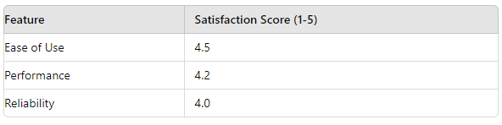
Methodologies: User Feedback and Reviews
Gathering User Experiences:
Surveys: Collect quantitative data on user satisfaction and feature usage.
Focus Groups: Obtain qualitative insights through discussions with selected user groups.
Usability Testing: Observe users interacting with the technology to identify pain points and areas for improvement.
Analysing Customer Satisfaction:
User Adoption Rates: Measure how quickly and extensively the technology is adopted by users.
Customer Satisfaction: Evaluate overall user happiness and areas of discontent.
Example Survey Results:

Slide 96
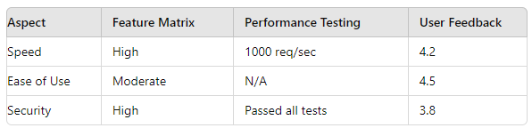
Methodologies: Integrating Methodologies in Comparative Analysis
Combining Data Sources:
Feature Comparison + Performance Testing:
Cross-reference feature matrix with performance benchmarks.
Ensure functional capabilities meet performance expectations.
User Feedback:
Validate findings from feature and performance analysis with user feedback.
Prioritise features and improvements based on user satisfaction and adoption rates.
Example Integration:

Slide 97
Impact of Emerging Technologies on Design Choices
Definition: Emerging technologies are innovative tools and solutions that have the potential to significantly impact various industries.
Purpose:
Transform traditional design processes.
Introduce new possibilities and efficiencies.
Require reassessment of current technology choices.

Slide 98
Impact of Emerging Technologies on Design Choices: Key Emerging Technologies
Artificial Intelligence (AI) and Machine Learning (ML)
Internet of Things (IoT)
Blockchain
5G Technology
Augmented Reality (AR) and Virtual Reality (VR)
Edge Computing

Slide 99
Key Emerging Technologies: AI and ML Impact on Design Choices
Automation:
Streamlines repetitive tasks.
Enhances decision-making processes.
Predictive Analytics:
Improves forecasting and trend analysis.
Enables proactive design adjustments.
Personalisation:
Tailors user experiences based on data insights.
Increases user engagement and satisfaction.
Example: AI-driven customer support systems providing real-time assistance.

Slide 100
Key Emerging Technologies: IoT Impact on Design Choices
Interconnectivity:
Facilitates seamless integration of devices.
Enhances real-time data exchange.
Smart Systems:
Promotes the development of intelligent infrastructure.
Improves efficiency in resource management.
Data Overload:
Necessitates robust data processing and storage solutions.
Requires efficient data analytics frameworks.
Example: Smart home systems integrating various IoT devices for automated control.

Slide 101
Key Emerging Technologies: Blockchain Impact on Design Choices
Security:
Provides enhanced security through decentralised ledgers.
Ensures data integrity and immutability.
Transparency:
Increases transparency in transactions.
Reduces the risk of fraud.
Decentralisation:
Eliminates the need for intermediaries.
Simplifies complex processes.
Example: Secure and transparent supply chain management systems.

Slide 102
Key Emerging Technologies: IoT Impact on Design Choices
Interconnectivity:
Facilitates seamless integration of devices.
Enhances real-time data exchange.
Smart Systems:
Promotes the development of intelligent infrastructure.
Improves efficiency in resource management.
Data Overload:
Necessitates robust data processing and storage solutions.
Requires efficient data analytics frameworks.
Example: Smart home systems integrating various IoT devices for automated control.

Slide 103
Key Emerging Technologies: 5G Technology Impact on Design Choices
High-Speed Connectivity:
Enables faster data transfer rates.
Supports high-bandwidth applications.
Low Latency:
Enhances real-time communication and interaction.
Benefits applications requiring immediate feedback.
Massive IoT Support:
Accommodates a large number of connected devices.
Facilitates the growth of smart cities and environments.
Example: Enhanced mobile experiences with real-time augmented reality applications.

Slide 104
Key Emerging Technologies: AR and VR Impact on Design Choices
Immersive Experiences:
Creates engaging and interactive environments.
Enhances user engagement and retention.
Virtual Prototyping:
Reduces costs and time in product development.
Allows for early detection of design flaws.
Training and Simulation:
Provides realistic training environments.
Improves learning outcomes and safety.
Example: Virtual reality training simulations for medical professionals.

Slide 105
Key Emerging Technologies: Edge Computing Impact on Design Choices
Reduced Latency:
Processes data closer to the source.
Improves response times for critical applications.
Bandwidth Efficiency:
Decreases the amount of data sent to centralised servers.
Optimises network usage and reduces costs.
Enhanced Security:
Minimises the risk of data breaches during transmission.
Ensures data privacy through localised processing.
Example: Real-time analytics in industrial IoT systems using edge computing.

Slide 106
Risk Assessment in Design Option Evaluation: Introduction
Introduction to Risk Assessment
Definition: Risk assessment is the process of identifying, analysing, and evaluating potential risks in design options to minimise negative impacts on project outcomes.
Purpose:
Ensure informed decision-making.
Mitigate potential issues early in the project lifecycle.
Enhance project success and stakeholder confidence.

Slide 107
Risk Assessment in Design Option Evaluation: Key Components
Risk Identification:
Identify potential risks related to design options.
Categorise risks (technical, financial, operational, etc.).
Risk Analysis:
Assess the likelihood and impact of identified risks.
Use qualitative and quantitative methods.
Risk Evaluation:
Prioritise risks based on their severity.
Determine the acceptability of risks.
Example: Identifying the risk of system incompatibility in integrating a new technology.

Slide 108
Risk Assessment in Design Option Evaluation: Risk Mitigation Strategies
Avoidance:
Eliminate the risk by choosing an alternative design option.
Example: Opting for a well-established technology instead of a nascent one.
Reduction:
Implement measures to reduce the likelihood or impact of the risk.
Example: Conducting thorough testing and validation before full deployment.
Transfer:
Shift the risk to another party, such as through insurance or outsourcing.
Example: Outsourcing data storage to a reliable third-party provider.
Acceptance:
Acknowledge the risk and prepare to manage its impact if it occurs.
Example: Creating a contingency plan for potential delays in project timelines.

Slide 109
User-Centered Design Approaches in IT Projects: Principles
Focus on Users:
Understand who the users are and their goals.
Conduct user research to gather insights into user behavior and needs.
Iterative Design:
Design, prototype, test, and refine in cycles.
Use feedback from each iteration to improve the design.
Design for Context:
Consider the environment in which the product will be used.
Ensure the design is appropriate for real-world usage scenarios.
Involve Users Throughout the Process:
Engage users early and often through surveys, interviews, and usability testing.
Validate design decisions with real user feedback.

Slide 110
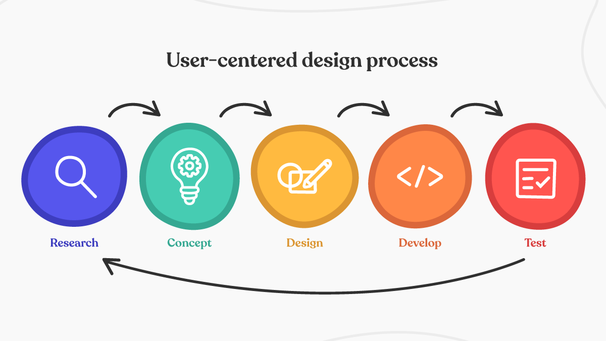
User-Centered Design Approaches in IT Projects: Process

Slide 111
Group Discussion Case Study
Scenario: are part of a software development team tasked with creating a new mobile application for a retail company. The app aims to enhance customer engagement by providing a seamless shopping experience, including product browsing, ordering, and personalised recommendations. The project manager emphasises the importance of adopting a User-Centered Design (UCD) approach to ensure the app meets user expectations and drives customer satisfaction.
Discussion Questions:
How would you gather insights into what features and functionalities customers want in the mobile app?
Why is it important to prioritise user preferences during the design phase?
How would you involve potential users in testing early prototypes to improve usability?
What are some simple ways to gather feedback from users on their experience with the app?

Slide 112
Case Study: Discussion Points
1. How would you gather insights into what features and functionalities customers want in the mobile app?
Conduct surveys and questionnaires to gather quantitative data on preferences.
Organise focus groups or interviews to understand qualitative insights and specific needs.
Analyse customer support queries and reviews for common feature requests and pain points.
2. Why is it important to prioritise user preferences during the design phase?
Ensures the app aligns with user expectations, enhancing user satisfaction.
Reduces the risk of developing features that users may not find useful.
Increases adoption rates and promotes long-term user engagement with the app.

Slide 113
Case Study: Discussion Points(Cont.)
3. How would you involve potential users in testing early prototypes to improve usability?
Recruit users from the target audience to participate in usability testing sessions.
Provide clear tasks and scenarios for users to perform during testing.
Gather feedback through observation, interviews, and post-test questionnaires to identify usability issues.
4. What are some simple ways to gather feedback from users on their experience with the app?
Implement in-app feedback forms or surveys that are easy to access and complete.
Encourage users to provide feedback through app store reviews and ratings.
Monitor social media channels and customer support interactions for direct user feedback.

Slide 114
Summary
Technology Selection Criteria: Define goals and requirements, assess scalability, compatibility, security, cost-effectiveness, and vendor support.
Comparative Analysis: Use feature matrices, benchmarks, and trend analysis to evaluate scalability, integration, industry alignment, and long-term viability.
Impact of Emerging Technologies: Enhance scalability, user interaction, and operational efficiency; address security and regulatory challenges.
Risk Assessment: Identify, prioritise, and mitigate risks using qualitative and quantitative methods.
User-Centered Design: Prioritise iterative user feedback, employ personas, scenarios, and usability testing for intuitive, user-centric solutions.

Slide 115
Q&A
Question?

